Slide 1
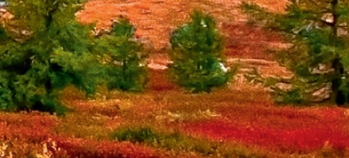
Chapter 3: Biodiverse ecosystems

Slide 2
A world of biomes
What factors influence the range and distribution of diverse organisms from one country to the next?
Earth is comprised of ecosystems
The sum of all ecosystems across the world is called the biosphere
Biomes are main categories of ecosystems across large geographical areas
Figure 1.1 The Royal
Menagerie (an early
form of the zoo), Tower of
London, 1816
Notes:
The world’s terrestrial biomes, for example, roughly correspond to major variations in vegetation types, climate, topography (the arrangement of physical features, both natural and artificial, of an area), and soil type. Tropical rainforest, deserts, grasslands and tundra are some examples of the world’s major terrestrial biomes.

Slide 3
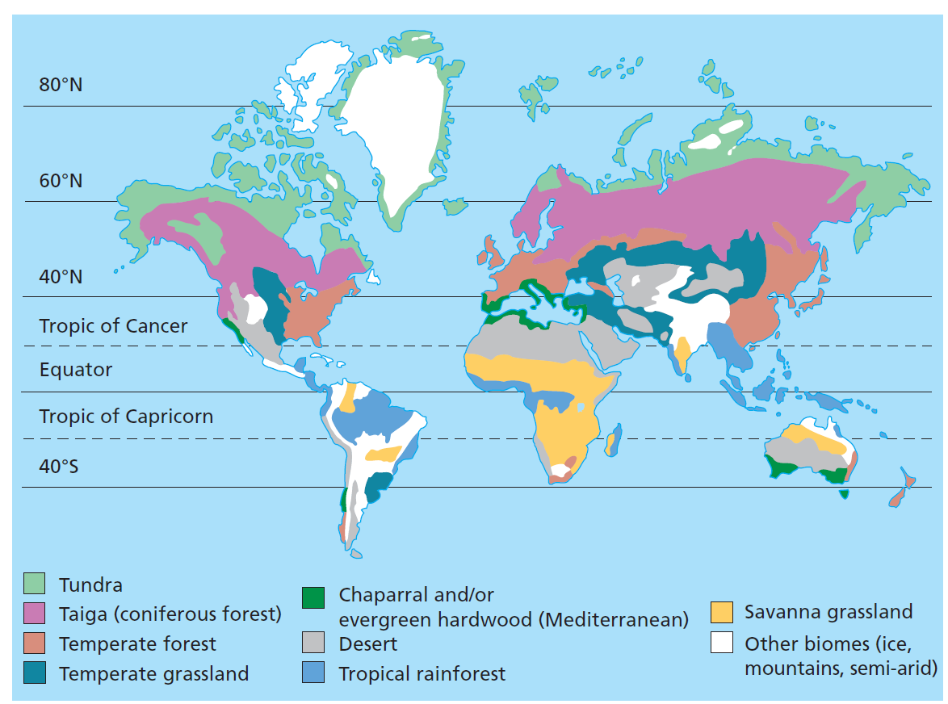
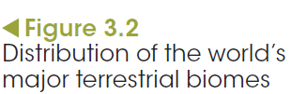
A world of biomes
Notes:
Enhanced views of Earth and its biosphere present patterns of browns and blues that identify the large terrestrial and aquatic biomes. Biomes are main categories of ecosystems across large geographical areas. Figure 3.2 shows the world’s major biomes and their distribution.

Slide 4
A world of biomes
Ecosystems, environments and habitats
Each biome consists of several different ecosystems
An ecosystem is classified as the interactions between the environment and its community
The community is the sum of all the living organisms in a habitat and the environment is the abiotic and biotic components of the ecosystem.
Figure 1.1 The Royal
Menagerie (an early
form of the zoo), Tower of
London, 1816
Notes:
The world’s ecosystems are diverse. They contain species that are directly linked to the abiotic and biotic factors within the ecosystem. To delve further into classifying areas, an ecosystem can contain many different habitats. A habitat is an area or environment where an individual of a species lives, feeds and reproduces, within an ecosystem. Habitats are therefore specific for each population. A population is a group of individuals belonging to the same species, living in the same habitat at the same time. For example, a rainforest ecosystem has several habitats. The ground level is home to the cassowary, a flightless bird, whereas the canopy level is home to the striped possum. The habitat for the cassowary is different to that of the striped possum despite living in the same ecosystem.

Slide 5
Test yourself
Learning check
Distinguish between:
a. population and community
b. environment and habitat
c. biotic and abiotic.
Figure 1.1 The Royal
Menagerie (an early
form of the zoo), Tower of
London, 1816
Notes:
Population: a group of individuals belonging to the same species living in a particular are at the same time.
Community: the sum of the different species inhabiting a particular habitat at one time.
Environment: abiotic and biotic factors of an area.
Habitat: an area or environment where an individual or species lives within an ecosystem.
Biotic: the living components of an ecosystem.
Abiotic: the non-living components of an ecosystem.

Slide 6
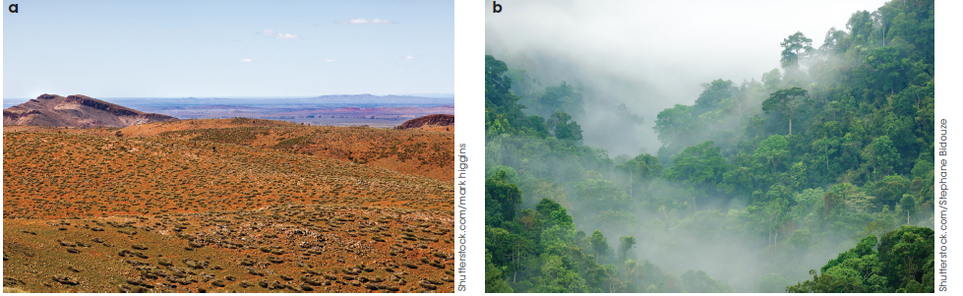
Classification of ecosystems and environments
Classifying environments
Terrestrial environments
The distribution of terrestrial environments such as tundra, deserts, open forests and temperate grasslands is based mainly on climatic variation.
Figure 3.5
Low rainfall in deserts limits biodiversity; high rainfall in tropical forests promotes greater biodiversity.
Notes:
Ecologists study the relationships between living things and their surroundings. This study is called ecology, a term first used by Ernst Heinrich Heinkel in 1869. In the early days, ecology was largely descriptive, providing qualitative data based on observational studies. It has become a more exact science utilising quantitative data measurements, and the development of models and theories that help us better understand relationships. Today, ecologists use both qualitative and quantitative data to classify ecosystems and environments based on their abiotic and biotic components.
Environments can be classified based on their biotic and/or abiotic factors. Abiotic factors are physical and chemical factors such as temperature, light intensity, texture and pH of the soil, concentration of significant gases in water or air, and the availability of water. Every organism is restricted to a particular area due to limiting factors. A limiting factor is an element of the environment that restricts the survival of an organism to a region.

Slide 7
Classification of ecosystems and environments
Classifying environments
Aquatic environments
Marine and freshwater environments
Marine 3% NaCl,
Freshwater 1% NaCl
Photosynthesis occurs in photic zone (first 200 m of ocean depth)
90% marine life resides in photic zone
Still bodies or moving bodies of water
Notes:
Aquatic environments include both marine (saltwater) and freshwater environments. They make up the largest part of the biosphere. The oceans alone cover 71% of Earth’s surface.
Examples of aquatic environments include moving waters of oceans, bays, estuaries, creeks, streams and rivers, and still waters of lakes, ponds and swamps.
The major substrate that defines whether a body of water is marine or fresh is the concentration of sodium chloride (salt). Marine environments are characterised by having a salt concentration of approximately 3%. On the other hand, freshwater environments have a salt concentration of less than 1%. Estuaries have fluctuating salt concentrations. During a high tide the salt concentration increases to almost equal to that of the ocean and decreases as the point of low tide approaches. As you move up the estuary the salt concentration almost equals that of fresh water.

Slide 8
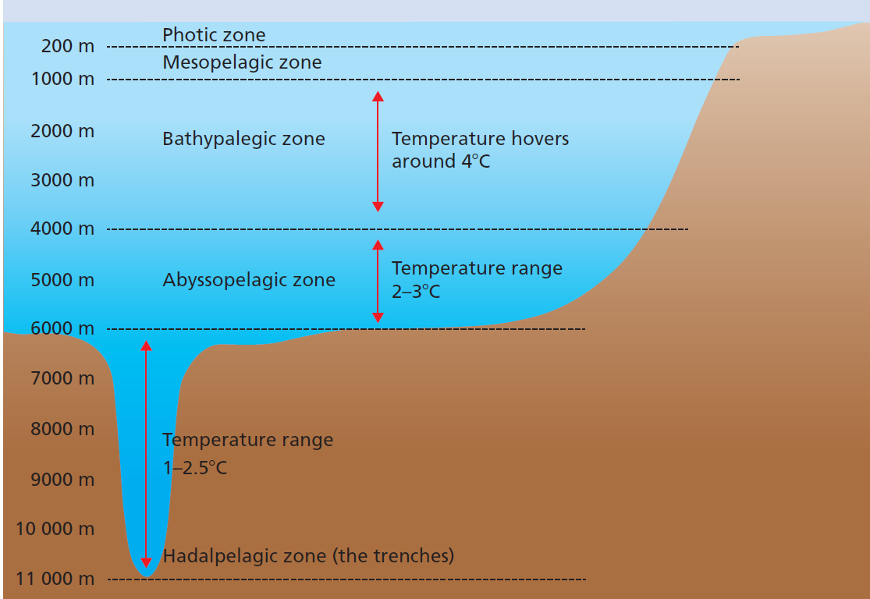
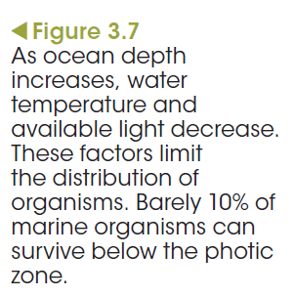
Classification of ecosystems and environments
Notes:
Ocean environments are classified according to depth, distance from the shoreline and the way they are formed. The first 200 m of ocean depth is known as the photic zone. This is the only part of the water that light can penetrate and accommodate photosynthesising organisms. Approximately 90% of marine life lives in the photic zone. The temperature ranges from approximately 34°C to 10°C. As the depth increases, water temperature decreases. Water between the depths of 200 and 1000 m is known as the mesopelagic zone. Some light penetrates this region, although it is not sufficient for the survival of
photosynthetic organisms. Temperatures range between 20°C in warmer areas and 4°C closer to 1000 m. Figure 3.7 shows a summary of the other oceanic zones and the temperature ranges.
As ocean depth increases organisms also feel the effects of increased pressure. This is another limiting factor of the distribution of marine organisms.

Slide 9
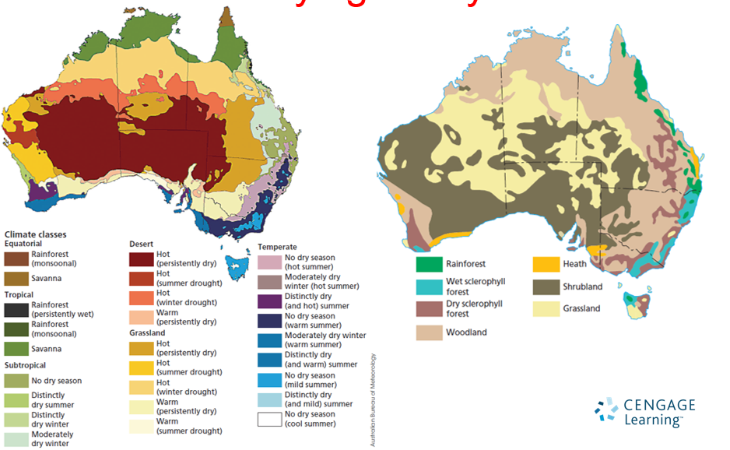

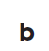
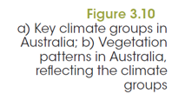
Classification of ecosystems and environments
Classifying ecosystems
Notes:
The distribution of ecosystems depends on factors such as soil type and climate, remembering that the ecosystem is the interaction between the species and these factors.
Figure 3.10(a) shows the key climatic groups that can be compared to Figure 3.10(b), which shows how the major vegetation patterns correspond to differing climates.
Generally speaking, the component species of an ecosystem will be some variety of plant.
Vegetation is classified according to:
• the percentage of ground shaded or covered by the tallest layer of vegetation
• the form (tree, shrub or grass) of the tallest layer.

Slide 10
Ecological niches
The way in which species function within their environment is an ecological niche.
For example, the time they feed, what they feed on, where they live and when they reproduce.
Fundamental niche: the potential region an organism could inhabit if there are no competitors, predators or parasites.
Realised niche: the actual niche a species inhabits.
Notes:
Abiotic factors suitable for the laughing kookaburra Dacelo novaeguineae extend virtually all the way down the eastern coast of Australia, from Cape York Peninsula in far north Queensland to the eastern Eyre Peninsula in SA, including Tasmania. However, the species is not distributed evenly throughout this geographical range as successful competitors occupy the kookaburra’s niche in certain areas.

Slide 11
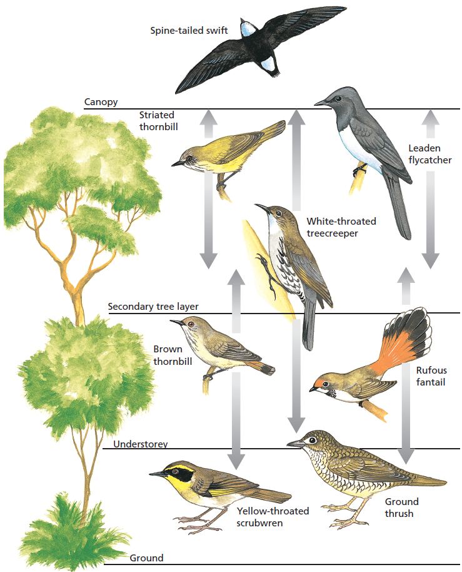
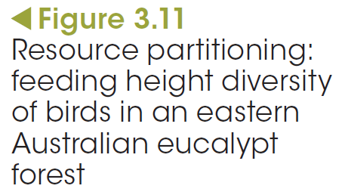
Ecological niches
Notes:
Different organisms that feed on the same foods will do so at different times or locations to avoid competition. This is resource partitioning.

Slide 12
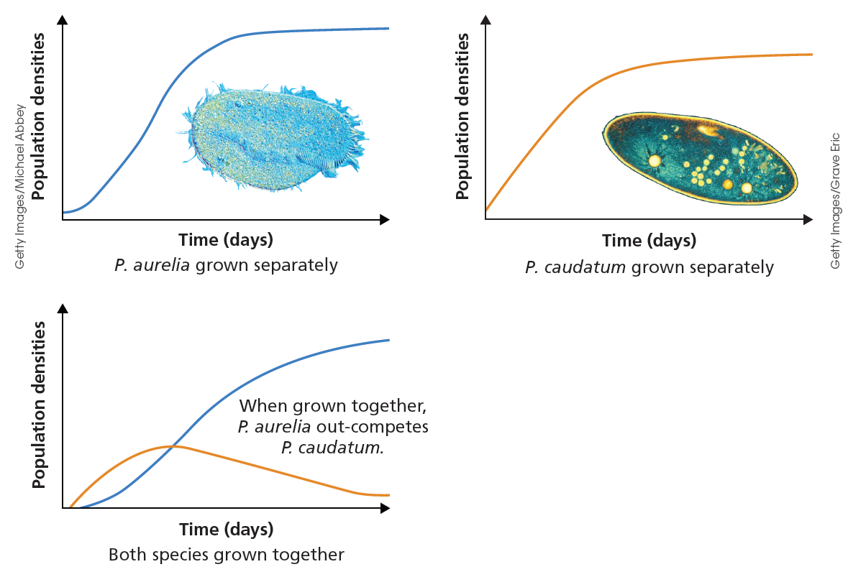
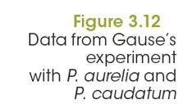

Ecological niches
Competitive exclusion principle
Notes:
The competitive exclusion principle states that two similar species that compete for a resource cannot coexist in the same community.

Slide 13
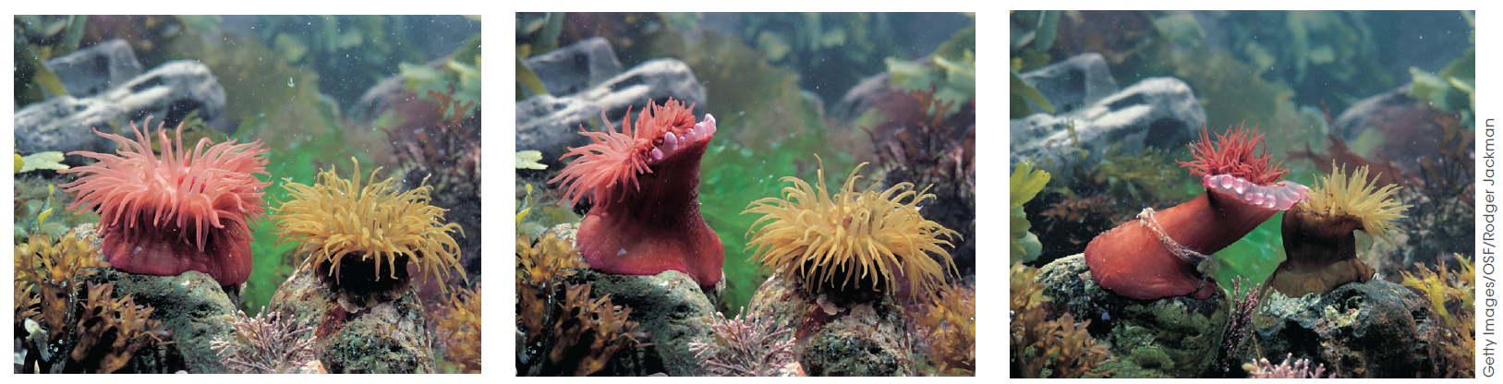
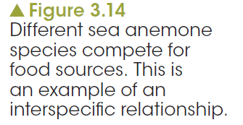
Relationships and interactions between living things
Competitor or collaborator?
Notes:
Understanding the relationships between organisms and their interactions with each other can help us understand how an ecosystem works. Some interactions can be straightforward but others are extremely complex. It is only by experimentation and painstaking studies of behaviour that scientists can come close to unravelling these relationships.
Communities consist of the complex interactions of different populations and the individuals within them. Many are in competition with each other; they require the same resources to fulfil their needs for survival. Competition within and between species is a common feature of all communities. For example, seemingly harmless sea anemones compete for the same food source with others of their species. They can detect slight genetic variations in intruders of the same species. Both rivals discharge a battery of stinging cells, normally used to paralyse and catch prey. In the end, one will admit defeat, close up and creep away.
Members of some species solve the problem of catching their prey by collaborating with each other as wolves do in hunting for their prey or dolphins when herding schools of fish.
These are examples of intraspecific interactions: relationships between members of the same species.
On the other hand, the association that wolves or dolphins have with their respective prey is interspecific: a relationship between members of different species.
The way in which one organism competes against or works with another organism to obtain their food helps shape the biodiversity of an ecosystem.

Slide 14
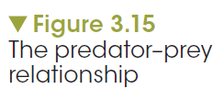
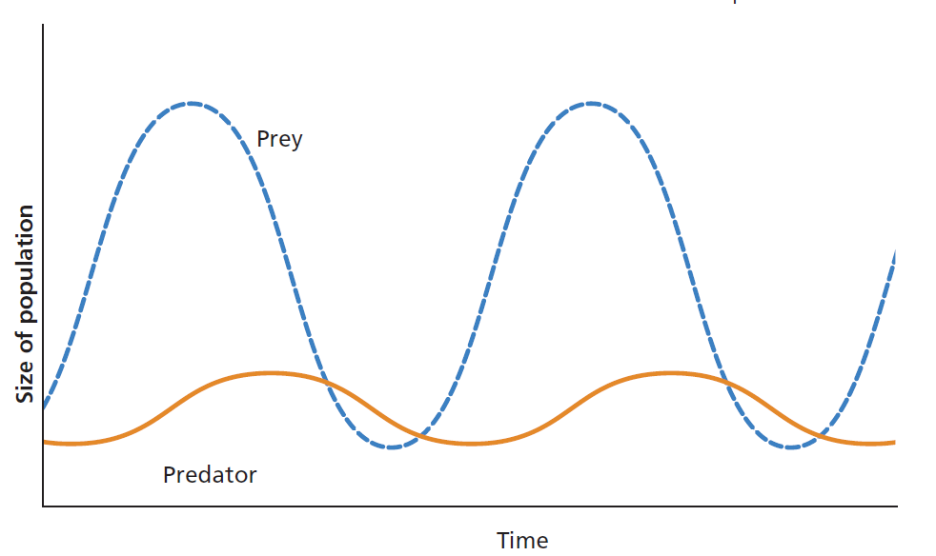
Relationships and interactions between living things
Predator and prey
Notes:
An obvious interaction within every ecosystem is a predator–prey relationship (Figure 3.15).
In this relationship one organism, the predator, kills another organism, the prey, or consumes part of it for its food. Although there is usually a preferred prey species, it is unusual for a predator to depend on only one species. It is an advantage for a predator to be a member of a network of food chains. If one prey species becomes in short supply, the predator can turn to others.

Slide 15
Relationships and interactions between living things
Disease
Disease is another important interaction that can impact on biodiversity of an ecosystem.
The host numbers may be reduced to the extent that resources are free for other competitors.
Notes:
For example, the myxomatosis virus causes a disease that affects rabbits. In Australia this virus is deliberately used to reduce the rabbit population to allow for native animal populations to increase. In this case the disease allows the biodiversity of the Australian ecosystem to be higher because without the virus the rabbits become overpopulated and outcompete the native animals for resources. On the other hand, disease can also decrease the biodiversity of an ecosystem. Chlamydia is a disease impacting upon the populations of koalas across Australia. It affects the reproductive tract of the koala resulting in the failure to produce offspring. This in turn leads to the loss of koala numbers and genetic diversity from particular ecosystems.

Slide 16
Symbiotic relationships
Symbiosis
There are three main types of symbiosis.
Parasitism: one species benefits at the expense of the other
Mutualism: both species in the relationship benefit and neither is harmed
Commensalism: one species benefits and the other neither benefits nor is harmed.

Slide 17
Co-existence: the power of a keystone species
Keystone species
Keystone species have a large influence over lower trophic levels.
Prevents any one of the organisms in the lower trophic levels from monopolising food, resources and space.
Allow for richer biodiversity within a restricted area.
Notes:
An interesting aspect of predation is that in some cases it can affect the coexistence of a number of other species. The purple sea star, Pisaster ochraceus, is a natural predator of mussels in the intertidal zones of Pacific Ocean seashores. When researcher Robert Paine removed purple sea stars from this environment, it resulted in the expansion of the population of resident mussels. The mussels displaced the other sessile organisms, such as barnacles and limpets, as they spread. The diversity of species in the area decreased from 15–20 invertebrates and algae to below five over the period of 3 years. When the sea stars were returned, the mussels were again preyed upon and the barnacles, limpets and other species were able to re-occupy the space. The predator, P. ochraceus, allowed the coexistence of other species with the same requirement for food and space.

Slide 18
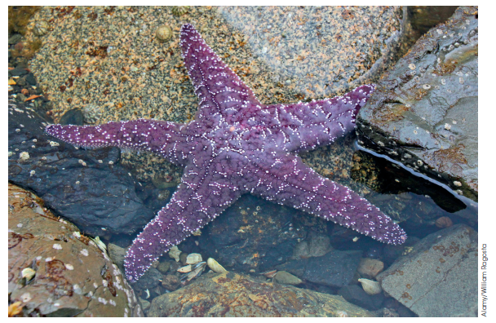
Test yourself
Learning check
How did the sea star improve the biodiversity of intertidal zones of Pacific Ocean seashores?
Figure 3.21
Pisaster ochraceus,
the purple sea star
Notes:
The purple sea star species is known as a keystone species. These species are seen to have a large influence over lower trophic levels. A keystone species prevents any one of the organisms in the lower trophic levels from monopolising food resources and space. Instead, they allow for richer biodiversity within a restricted area.

